Slide 1
Ranking the importance of fire refugia
Anthony Martinez

Slide 2
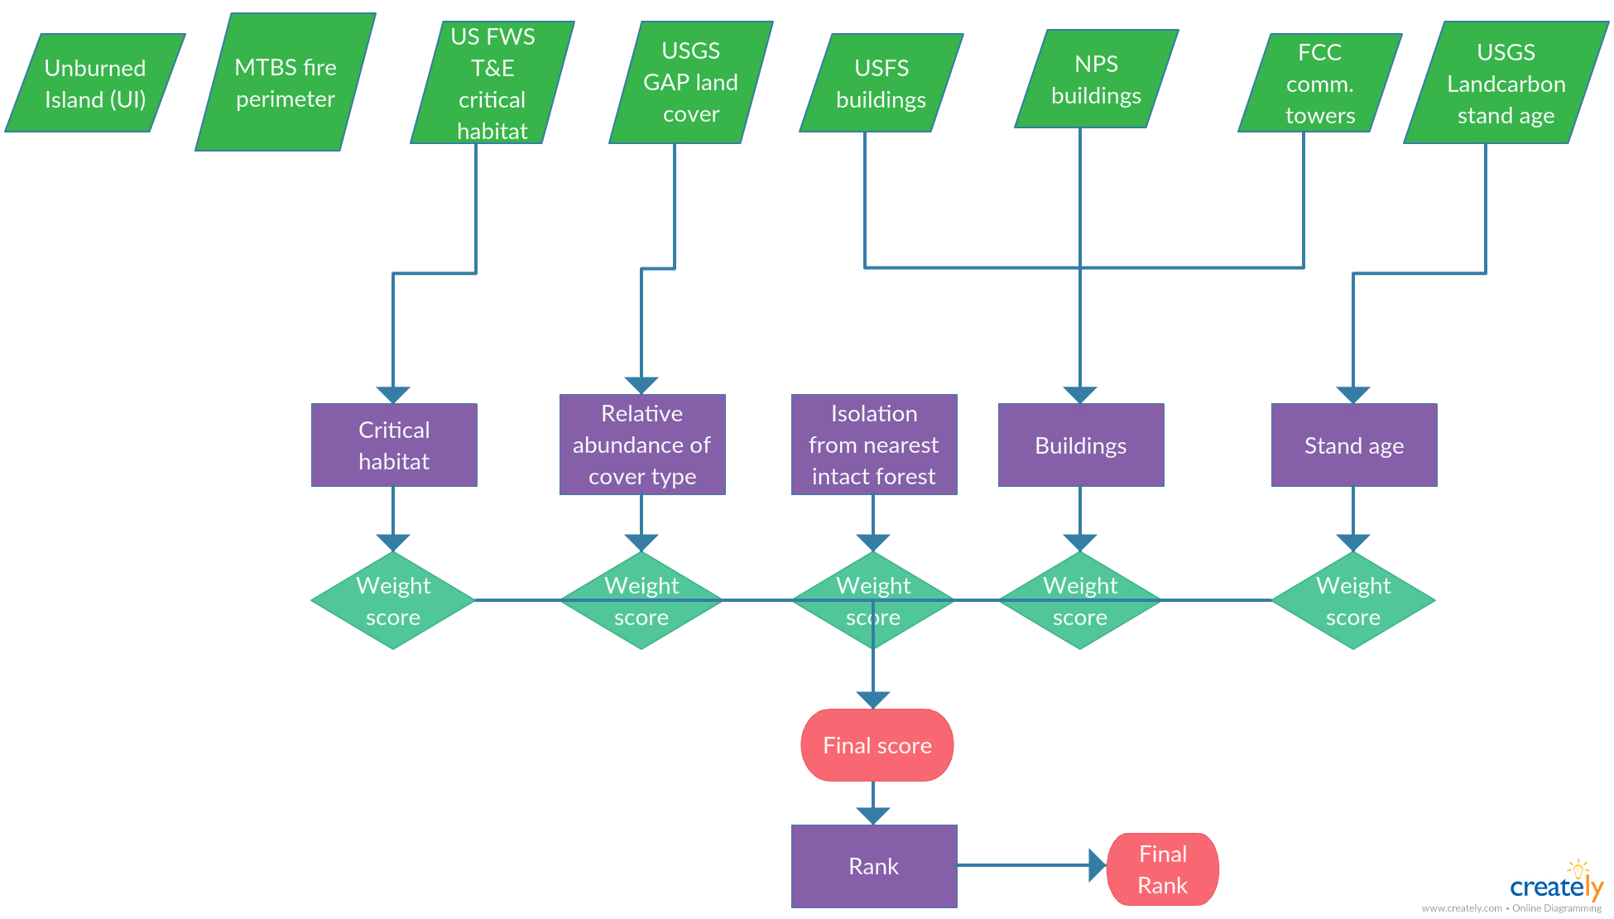
General Workflow

Slide 11
Datasets
Metric | Dataset | Source Agency | Coverage | Resolution (raster)
- | MTBS Fire perimeters | Interagency | PNW | -
- | Unburned Island | Meddens et. al | PNW | -
Isolation | - | - | - | -
Critical habitat | T & E species Critical habitat | USFWS | US | -
Cover type abundance | GAP land cover | USGS | PNW (WA, OR, ID) | 30 m
Buildings | USFS buildings | USFS | US | -
 | NPS buildings | NPS | US | -
 | Comm. towers | FCC | US | -
Stand age | Landcarbon stand age | USGS | US | 250 m
R scripts available at https://github.com/amart90/Fire-Refugia-Ranking

Slide 12
Choose the most important fire refugia
Resilience
Biodiversity
Persistance
Infrastructure
Buildings
Goal
Criteria
Sub-criteria
Relative abundance of cover type
Comm. Towers
Spatial pattern
Isolation
Abundance (of cover type)
Size
Relative abundance of cover type
Accessibility
Proximity to user
Cost/feasibility

Slide 13
Choose the most important fire refugia
Resilience
Buildings
Biodiversity
Persistence
Infrastructure
Communication towers
Spatial pattern
Isolation
Abundance of cover type
Size
Accessibility
Proximity to user
Cost/feasibility

